Slide 1
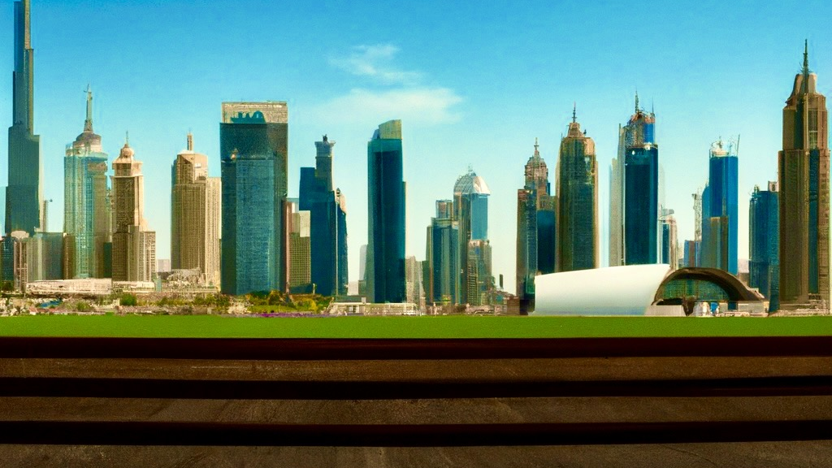
City Slicker
We’ll get you around!

Slide 2




Traveling’s a Travesty
Travel times and routes are tricky
People know what they want, but don’t know where to go…
Weather dictates wardrobe
At the end of day, can I accomplish my tasks in time?
To do Take Molly to recital Doctor Appt. Lunch with Jim Buy office supplies Spin Class- Maybe?

Slide 3
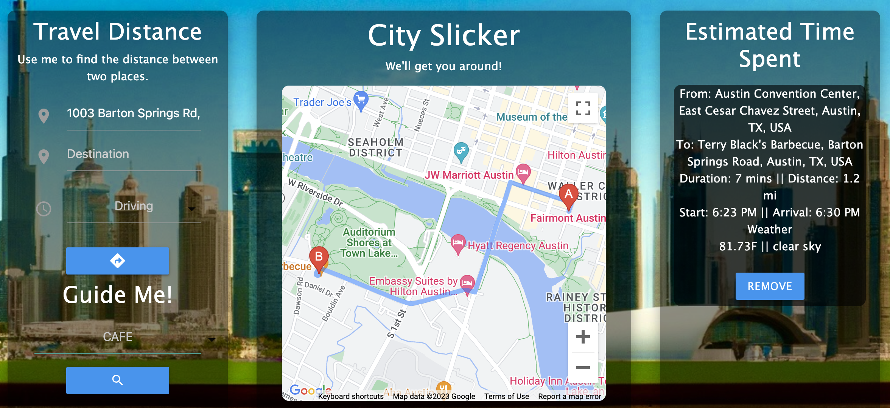
City Slicker
Get time and distances for routes
Get weather information about destination
Get suggestions for places to go in an area of interest
*Generate a list of travel activity*

Slide 4








Build Process
Tech Stack
API’S CSS Programming GAN
Successes
1. API’s work very well together 2. JavaScript and Jquery functions run the app without issue 3. City Slicker is fully functional!
Challenges
1. API’s can be difficult to integrate 2. Programming functions can be buggy

Slide 5




City Slickers
Russo B.
Google Maps API
HTML
CSS/ Web Design
Jack Kendrick
JavaScript Functions
HTML
Tshakalisa Khupe
CSS/ Web Design
HTML
Nicholas Ortiz
Weather API
GitHub Admin
CSS/ Web Design

Slide 6
Demo
City Slicker

Slide 7




Future Development
Expansion to include more involved travel plans:
Additional option to travel via flight
Travel time dependent on user preference
More detailed weather information
Recommendations to include customer reviews

Slide 8
Links
Link to GitHub Pages: https://mogleybear06.github.io/CitySlicker/
Link to repo: https://github.com/MogleyBear06/CitySlicker.git

